Slide 1



PROGRESS REPORT
DISTRICT – HINGOLI
AURANGABAD REGION
MARCH, 2023

Slide 2
District Overview
Taluka | Category | No. of Schemes |  | Work Order Issued |  | Work In Progress |  | Work Not Started
 |  | PMC | TSP | PMC | TSP | PMC | TSP | PMC | TSP
Aundha Nag | Retro | 35 | 10 | 35 | 10 | 17 | 6 | 18 | 4
 | New | 31 | 16 | 31 | 16 | 16 | 8 | 15 | 8
Basmath | Retro | 38 | 16 | 38 | 16 | 20 | 7 | 18 | 9
 | New | 24 | 26 | 24 | 26 | 14 | 6 | 10 | 20
Hingoli | Retro | 37 | 0 | 37 | 0 | 17 | 0 | 20 | 0
 | New | 40 | 15 | 40 | 15 | 16 | 9 | 24 | 6
Kalamnuri | Retro | 40 | 24 | 40 | 24 | 24 | 11 | 16 | 13
 | New | 16 | 21 | 16 | 21 | 6 | 5 | 10 | 16
Sengaon | Retro | 37 | 0 | 37 | 0 | 22 | 0 | 15 | 0
 | New | 48 | 16 | 48 | 16 | 25 | 11 | 23 | 5
Total | Retro | 187 | 50 | 187 | 50 | 100 | 24 | 87 | 26
 | New | 159 | 94 | 159 | 94 | 77 | 39 | 82 | 55
Grand Total |  | 346 | 144 | 346 | 144 | 177 | 63 | 169 | 81
 |  | 490 |  | 490 |  | 240 |  | 250

Slide 3
Executive Summary Work in Progress Schemes
Taluka | Category | No. of Schemes | No. of Schemes based on Physical Progress %
 |  |  | < 25% | 25 < 50% | 50 < 75% | 75 < 100% | Commissioned
Aundha Nag | Retro | 23 | 17 | 3 | 3 | 0 | 0
 | New | 24 | 16 | 6 | 2 | 0 | 0
Basmath | Retro | 27 | 16 | 7 | 4 | 0 | 0
 | New | 20 | 13 | 6 | 1 | 0 | 0
Hingoli | Retro | 17 | 13 | 4 | 0 | 0 | 0
 | New | 25 | 23 | 2 | 0 | 0 | 0
Kalamnuri | Retro | 35 | 28 | 6 | 1 | 0 | 0
 | New | 11 | 9 | 2 | 0 | 0 | 0
Sengaon | Retro | 22 | 16 | 5 | 1 | 0 | 0
 | New | 36 | 33 | 3 | 0 | 0 | 0
Total | Retro | 124 | 90 | 25 | 9 | 0 | 0
 | New | 116 | 94 | 19 | 3 | 0 | 0
Grand Total |  | 240 | 184 | 44 | 12 | 0 | 0

Slide 4
Abstract of Schemes – Work in Progress Category – “Retro”
Sr No | Scheme Name | Name of Agency | W.O. Amount (excl GST) | W.O. Date | Construction Period | Physical Progress | RA Bill (Recommended) % | RA Bill (Recommended) In Lakhs
Aundha Nag Taluka
1 | Walki | Soham Costruction | 42,57,202 | 10-05-2022 | 17 Months | 63.15% | 15.73% | 6.69
2 | Kamtha | Dipak Viththalrao Chavhan | 44,24,198 | 14-10-2022 | 15 Months | 52.10% | - | -
3 | Kundkar Pimpri | Chandrakant Devidasrao Kande | 89,64,573 | 20-10-2022 | 15 Months | 51.12% | - | -
4 | Gangalwadi | Shivkumar Madhavrao Meghalwad | 56,64,097 | 21-10-2022 | 15 Months | 27.20% | - | -
5 | Pazar Tanda | Shri Akash Devidas Chatse | 43,48,942 | 12-09-2022 | 17 Months | 25.24% | - | -
6 | Sarangwadi | Nilkantheshwar Buildcon | 26,89,018 | 20-10-2022 | 15 Months | 25.24% | - | -
7 | Sirla | Ganesh Sanjay Nagre | 95,54,992 | 09-11-2022 | 15 Months | 17.43% | - | -
8 | Pimpaldari Tarf Nandapur | Nishchal Nemchand Yambal | 1,99,09,977 | 14-12-2022 | 15 Months | 16.20% | - | -
9 | Sirla Tanda | Ganesh Sanjay Nagre | 79,10,788 | 20-10-2022 | 15 Months | 15.78% | - | -
10 | Mardi | Keshav Gyanu Shankat | 62,55,884 | 09-11-2022 | 15 Months | 12.93% | - | -
11 | Anjanwadi | Yogesh Prabhakar Ghuge | 1,50,79,187 | 23-11-2022 | 15 Months | 9.51% | - | -
12 | Yehalegaon Solanke | Ambarwadikar Construction | 1,85,25,852 | 09-11-2022 | 15 Months | 7.85% | - | -
13 | Murtijapur Sawangi | Tukaram Dadarao Deshmukh | 1,71,64,997 | 21-10-2022 | 15 Months | 7.61% | - | -

Slide 5
Abstract of Schemes – Work in Progress Category – “Retro”
Sr No | Scheme Name | Name of Agency | W.O. Amount (excl GST) | W.O. Date | Construction Period | Physical Progress | RA Bill (Recommended) % | RA Bill (Recommended) In Lakhs
14 | Jalaldabha | Swarup Suresh Jadhav | 96,98,361 | 30-08-2022 | 15 Months | 7.32% | - | -
15 | Bramhanwada | Shubham Shivajirao Sangale | 46,73,528 | 06-05-2022 | 11 Months | 7.05% | - | -
16 | Rajapur | Shri Swarup Suresh Jadhav | 50,23,866 | 14-10-2022 | 15 Months | 6.39% | - | -
17 | Matha | Bhushan Devendra Jaiswal | 1,05,47,348 | 27-09-2022 | 15 Months | 6.09% | - | -
18 | Chondi T Shahapur | Shri Pranav Satyanarayan Agrawal | 1,29,35,393 | 09-11-2022 | 15 Months | 5.96% | - | -
19 | Berula | Tanuja Construction | 68,03,990 | 21-10-2022 | 15 Months | 1.19% | - | -
20 | Pota Kh | Anjali Lahu Naikwade | 87,54,217 | 09-11-2022 | 15 Months | 0.90% | - | -
21 | Wagarwadi | Shri Vaman Jhelaji Hirwe | 80,36,070 | 14-10-2022 | 15 Months | 0.87% | - | -
22 | Wagarwadi Tanda | Shri Vaman Jhelaji Hirwe | 1,08,95,839 | 14-10-2022 | 15 Months | 0.64% | - | -
23 | Rupur | Tanuja Construction | 1,53,24,438 | 30-12-2022 | 15 Months | 0.53% | - | -
Basmath Taluka
24 | Telgaon | Sachin Mujaji Katore | 38,99,594 | 29-04-2022 | 18 Months | 66.83% | - | -
25 | Khaparkheda | Murlidhar Damu Warkade | 44,03,840 | 09-11-2022 | 15 Months | 66.45% | - | -
26 | Kudala | Gajanan Shambhajirao Padole | 57,93,069 | 10-05-2022 | 11 Months | 53.42% | 28.20% | 16.33

Slide 6
Abstract of Schemes – Work in Progress Category – “Retro”
Sr No | Scheme Name | Name of Agency | W.O. Amount (excl GST) | W.O. Date | Construction Period | Physical Progress | RA Bill (Recommended) % | RA Bill (Recommended) In Lakhs
27 | Mohagaon | Archana Manikrao Kardile | 20,04,421 | 12-30-2022 | 15 Months | 51.74% | - | -
28 | Sarola | Karan Interprises | 48,30,673 | 06-10-2022 | 15 Months | 46.53% | - | -
29 | Rajapur | Ramesh Shrirangrao Argade | 76,36,840 | 10-14-2022 | 15 Months | 46.30% | - | -
30 | Jawala Kh | Supesto Construction | 34,24,555 | 02-05-2022 | 9 Months | 45.12% | 21.41% | 7.33
31 | Loan Bk | Amit Arun Awasarmal | 65,53,676 | 23-06-2022 | 15 Months | 35.88% | - | -
32 | Puyani Kh | Supestro Construction | 24,92,108 | 02-05-2022 | 9 Months | 32.04% | - | -
33 | Waghi | Sachin Ankushrao Garad | 74,42,494 | 14-11-2022 | 15 Months | 25.92% | - | -
34 | Parwa | Karan Interprises | 36,84,495 | 06-10-2022 | 15 Months | 25.91% | - | -
35 | Parli | Nrusinha Traders And Contractors | 41,88,474 | 10-05-2022 | 17 Months | 24.70% | - | -
36 | Hapsapur | Anil Subhasrao Shelke | 98,42,588 | 10-14-2022 | 15 Months | 21.20% | - | -
37 | Mhatargaon | Sachin Mujanji Katore | 56,76,770 | 14-03-2022 | 17 Months | 18.27% | - | -
38 | Pardi Kh | Ram Gyandev Bhalerao | 1,24,07,418 | 08-12-2022 | 15 Months | 16.72% | - | -
39 | Jawala T Babhulgaon & Khandarban | Karan Interprises | 1,11,61,613 | 06-10-2022 | 15 Months | 13.91% | - | -
40 | Reulgaon | Archna Manikrao Kardile | 1,30,73,830 | 14-10-2022 | 15 Months | 11.05% | - | -

Slide 7
Abstract of Schemes – Work in Progress Category – “Retro”
Sr No | Scheme Name | Name of Agency | W.O. Amount (excl GST) | W.O. Date | Construction Period | Physical Progress | RA Bill (Recommended) % | RA Bill (Recommended) In Lakhs
41 | Malwata | Kedar Construction | 79,99,984 | 06-10-2022 | 17 Months | 10.76% | - | -
42 | Wartala | Qureshi Samir Ahemad Nasir Ahemad | 55,24,912 | 11-09-2022 | 15 Months | 9.22% | - | -
43 | Shingi | Ganesh Sanjay Nagre | 57,34,214 | 11-23-2022 | 15 Months | 9.07% | - | -
44 | Bhoripgaon | Jaiprakash Kondibarao Fegde | 61,23,065 | 21-10-2022 | 15 Months | 7.95% | - | -
45 | Kurundwadi | Sachin Munjaji Katore | 89,07,167 | 21-10-2022 | 15 Months | 7.68% | - | -
46 | Dagadpimpri | Shri Vaman Jhelaji Hirve | 20,04,504 | 06-10-2022 | 17 Months | 6.81% | - | -
47 | Palsagaon T Malwata | Shri Abhijeet Rameshrao Dhavle | 1,32,91,043 | 04-10-2022 | 15 Months | 6.52% | - | -
48 | Tembhurni | Amit Arun Awasarmal | 1,10,82,649 | 23-06-2022 | 15 Months | 6.33% | - | -
49 | Ganeshpur | Shri Datta Ramkrashn Tanpure | 1,56,56,526 | 14-10-2022 | 15 Months | 4.42% | - | -
50 | Kawatha | Karab Enterprises | 80,79,622 | 30-08-2022 | 15 Months | 4.26% | - | -
Hingoli Taluka
51 | Limbala Pr Washim | Tirupati Construction | 23,22,144 | 14-10-2022 | 17 Months | 47.01% | - | -
52 | Nandura | Supestro Construction Pvt Ltd | 1,19,15,175 | 30-12-2022 | 15 Months | 31.72% | - | -
53 | Swarkheda | Shri Gyaneshwar Garad | 51,55,741 | 15-07-2022 | 9 Months | 30.30% | - | -

Slide 8
Abstract of Schemes – Work in Progress Category – “Retro”
Sr No | Scheme Name | Name of Agency | W.O. Amount (excl GST) | W.O. Date | Construction Period | Physical Progress | RA Bill (Recommended) % | RA Bill (Recommended) In Lakhs
54 | Bhogaon | Nagre Construction | 14,64,918 | 10-05-2022 | 15 Months | 29.61% | - | -
55 | Durg Sawangi | Rishikesh Namdev Musle | 1,04,82,559 | 14-10-2022 | 15 Months | 18.23% | - | -
56 | Hingni | Aadinath Construction | 77,65,426 | 14-10-2022 | 15 Months | 11.12% | - | -
57 | Paheni | Vaishnavi Construction | 1,55,24,994 | 23-11-2022 | 15 Months | 10.30% | - | -
58 | Devthana | Supestro Constructin Pvt. Ltd. | 1,46,07,185 | 15-12-2022 | 15 Months | 9.68% | - | -
59 | Incha | Supestro Construction | 1,47,89,354 | 09-11-2022 | 15 Months | 9.31% | - | -
60 | Sawad | Mannaspimprikar Construction | 1,09,84,017 | 23-11-2022 | 15 Months | 8.63% | - | -
61 | Kothalaj | Shri Dadasaheb Baburao Khindkar | 91,23,978 | 04-10-2022 | 15 Months | 8.58% | - | -
62 | Vaijapur | Shri Gyaneshwar Gangaram Garad | 71,07,153 | 18-10-2022 | 15 Months | 8.17% | - | -
63 | Mop | Pandurang Punjaji Mule | 76,32,995 | 14-10-2022 | 15 Months | 7.33% | - | -
64 | Pimpaldari T Basamba | Bhushan Devendra Jaiswal | 1,10,87,118 | 21-10-2022 | 15 Months | 6.82% | - | -
65 | Borja | Tirupati Construction | 84,01,676 | 11-09-2022 | 15 Months | 0.84% | - | -
66 | Belwadi | Shankat Keshav Gyanu | 55,23,840 | 05-12-2022 | 15 Months | 0.15% | - | -
67 | Idoli | Pandurang Mule | 1,10,10,994 | 14-11-2022 | 15 Months | 0.08% | - | -

Slide 9
Abstract of Schemes – Work in Progress Category – “Retro”
Sr No | Scheme Name | Name of Agency | W.O. Amount (excl GST) | W.O. Date | Construction Period | Physical Progress | RA Bill (Recommended) % | RA Bill (Recommended) In Lakhs
Kalamnuri Taluka
68 | Belmandal | Mannaspimprikar Construction | 94,30,385 | 14-10-2022 | 15 Months | 55.04% | - | -
69 | Chafnath | Sanket Rajaram Chandel | 83,74,513 | 14-10-2022 | 15 Months | 46.83% | - | -
70 | Asola | Amol Devidas Ghodge | 50,37,734 | 10-05-2022 | 15 Months | 41.24% | 12.63% | 6.36
71 | Kumbharwadi T Chafnath | Mahesh Construction And Contractor | 82,69,029 | 06-10-2022 | 17 Months | 39.20% | - | -
72 | Yelki | Amol Devidas Ghodge | 1,35,18,602 | 21-10-2022 | 15 Months | 36.73% | - | -
73 | Ghoda | Jai Ambika Enterprises | 1,17,75,227 | 12-12-2022 | 15 Months | 33.25% | - | -
74 | Sukalivalan | Ashrafi Abdul Mavud Mo. Abdul | 62,35,626 | 21-10-2022 | 15 Months | 27.53% | - | -
75 | Naukha Tarfe Kalmnuri | Shri Amol Devidas Ghodge | 27,12,800 | 21-10-2022 | 15 Months | 24.73% | - | -
76 | Yegaon | Sayyad Mohseenoddin Sayyad Asadulla Kadri | 30,16,246 | 14-10-2022 | 15 Months | 21.90% | - | -
77 | Yehalegaon Tukaram | D.D. Jaiswal | 1,33,73,845 | 20-10-2022 | 15 Months | 21.49% | - | -
78 | Kadapdeo | She. Irfan She. Abdul | 61,16,788 | 14-10-2022 | 15 Months | 20.43% | - | -
79 | Adha | Shri Akshay Kailash Shinde | 32,80,086 | 10-05-2022 | 11 Months | 17.03% | - | -
80 | Arati | Bharati Ramesh Sanap | 21,16,020 | 06-10-2022 | 17 Months | 15.27% | - | -

Slide 10
Abstract of Schemes – Work in Progress Category – “Retro”
Sr No | Scheme Name | Name of Agency | W.O. Amount (excl GST) | W.O. Date | Construction Period | Physical Progress | RA Bill (Recommended) % | RA Bill (Recommended) In Lakhs
81 | Salegaon | D.D. Jaiswal | 1,29,35,858 | 14-10-2022 | 15 Months | 14.90% | - | -
82 | Chuncha | Pratibha Construction | 1,61,48,581 | 20-07-2022 | 17 Months | 13.89% | - | -
83 | Gundalwadi | Amol Devidas Ghodge | 55,43,786 | 10-05-2022 | 15 Months | 12.56% | 10.18% | 5.64
84 | Shivani Bk | Momeen Mobeen Mehmud | 65,72,414 | 18-10-2022 | 15 Months | 12.14% | - | -
85 | Mahari Bk | Jai Bhole Construction | 57,23,600 | 05-12-2022 | 15 Months | 10.24% | - | -
86 | Kasabe Dhawanda | Amol Devidas Ghodge | 1,15,15,225 | 05-12-2022 | 15 Months | 9.32% | - | -
87 | Bhategaon | Bhagwanbaba Construction | 1,27,19,183 | 14-10-2022 | 15 Months | 8.47% | - | -
88 | Warud,Chinchwadi & Devwadi | Mannaspimprikar Construction | 2,10,25,296 | 29-12-2022 | 15 Months | 8.32% | - | -
89 | Wai | Nachiket Yashvantrao Shinde | 85,78,661 | 14-10-2022 | 15 Months | 7.19% | - | -
90 | Salwa | Jai Ambika Enterprises | 2,19,52,540 | 23-11-2022 | 15 Months | 5.82% | - | -
91 | Khaparkheda | Momin Mobin Mehmud | 97,22,274 | 18-01-2023 | 15 Months | 5.82% | - | -
92 | Naukha Tarfe Kalamnuri | Amol Devidas Ghodange | 27,12,800 | 21-10-2022 | 15 Months | 5.24% | - | -
93 | Kandli | Kaji Earthmovers & Land Developers | 3,14,73,242 | 14-12-2022 | 15 Months | 4.85% | - | -
94 | Kalamkonda | Momeen Mobin Mehmud | 77,53,758 | 18-10-2022 | 15 Months | 3.20% | - | -

Slide 11
Abstract of Schemes – Work in Progress Category – “Retro”
Sr No | Scheme Name | Name of Agency | W.O. Amount (excl GST) | W.O. Date | Construction Period | Physical Progress | RA Bill (Recommended) % | RA Bill (Recommended) In Lakhs
95 | Shewala | Pratibha Construction | 2,19,42,326 | 23-11-2022 | 15 Months | 2.75% | - | -
96 | Sandas Tarf Nandapur | Mannaspimprikar Construction | 1,75,91,683 | 30-12-2022 | 15 Months | 1.49% | - | -
97 | Morwadi | Mannaspimprikar Construction | 1,17,02,078 | 05-12-2022 | 15 Months | 0.97% | - | -
98 | Kanhegaon | Ajay Jagannath Sawant | 1,02,94,339 | 30-12-2022 | 15 Months | 0.71% | - | -
99 | Devjana | Ajay Jagannath Sawant | 85,65,622 | 05-12-2022 | 15 Months | 0.70% | - | -
100 | Wakodi | Pathan Farman Khan Abdulla Khan | 1,40,24,578 | 21-10-2022 | 15 Months | 0.50% | - | -
101 | Kamtha | Mohammad Shoeb Shaikh Faruk | 89,28,341 | 14-10-2022 | 15 Months | 0.17% | - | -
102 | Datti | Kaji Earth Movers & Developers | 1,13,25,182 | 14-10-2022 | 15 Months | 0.11% | - | -
Sengaon Taluka
103 | Gondankheda | Astavinayak Group | 33,75,116 | 05-04-2022 | 17 Months | 61.54% | 53.82% | 18.17
104 | Shivni Bk | Supesto Construction | 43,59,143 | 10-05-2022 | 17 Months | 47.08% | 38.79% | 16.91
105 | Datada Bk | Nagre Construction | 53,67,210 | 10-05-2022 | 9 Months | 47.00% | 38.51% | 20.67
106 | Suldali Bk & Belkheda | Shivaji Mahadev Devkar | 1,09,29,940 | 06-10-2022 | 15 Months | 32.03% | - | -
107 | Dhanora Banjara | Vaishnavi Construction | 66,96,902 | 06-10-2022 | 15 Months | 27.08% | - | -

Slide 12
Abstract of Schemes – Work in Progress Category – “Retro”
Sr No | Scheme Name | Name of Agency | W.O. Amount (excl GST) | W.O. Date | Construction Period | Physical Progress | RA Bill (Recommended) % | RA Bill (Recommended) In Lakhs
108 | Hanakdari | Nagre Construction | 43,26,699 | 10-05-2022 | 15 Months | 25.88% | 12.68% | 5.49
109 | Warkheda | Bhagwanbaba Construction | 83,18,577 | 09-11-2022 | 15 Months | 23.44% | - | -
110 | Limbala Tanda | Ambarwadikar Construction | 1,42,90,957 | 09-11-2022 | 15 Months | 13.19% | - | -
111 | Warud Chakrapan | Shivaji Mahadev Devkar | 1,05,44,058 | 06-10-2022 | 15 Months | 8.69% | - | -
112 | Kapadshingi | Shri Datta Ramkrishn Tanpure | 1,98,95,794 | 14-10-2022 | 15 Months | 8.67% | - | -
113 | Suldali Kh | Mahesh Construction & Contractors | 57,86,370 | 28-11-2022 | 15 Months | 6.69% | - | -
114 | Mannas Pimpri | Mannaspimprikar Construction | 1,09,69,677 | 20-10-2022 | 15 Months | 6.53% | - | -
115 | Devkarwadi | Vaishnavi Construction | 99,27,764 | 14-12-2022 | 15 Months | 5.66% | - | -
116 | Datala Kh | Shri P.P. Mule | 37,43,902 | 15-07-2022 | 15 Months | 5.39% | - | -
117 | Shindephal | Aakash Devidas Chatse | 77,72,872 | 20-10-2022 | 15 Months | 2.89% | - | -
118 | Yeldari | Ambarwadikar Construction | 51,24,003 | 14-10-2022 | 15 Months | 2.64% | - | -
119 | Mazod | Mannaspimprikar Construction | 1,26,16,228 | 14-12-2022 | 15 Months | 2.47% | - | -
120 | Bhankheda | Shri Aakash Devidas Chatse | 91,41,516 | 09-09-2022 | 15 Months | 1.88% | - | -
121 | Tandulwadi | Mahesh Construction & Contractor | 34,01,327 | 06-10-2022 | 17 Months | 0.68% | - | -

Slide 13
Abstract of Schemes – Work in Progress Category – “Retro”
Sr No | Scheme Name | Name of Agency | W.O. Amount (excl GST) | W.O. Date | Construction Period | Physical Progress | RA Bill (Recommended) % | RA Bill (Recommended) In Lakhs
122 | Shivani Kh | Pandurang Mule | 67,01,322 | 14-10-2022 | 15 Months | 0.65% | - | -
123 | Waychal Pimpri | Dinesh Uttam Jadhav | 1,50,18,332 | 14-12-2022 | 15 Months | 0.54% | - | -
124 | Makodi | Bhagwanbaba Construction | 1,31,12,564 | 14-10-2022 | 15 Months | 0.30% | - | -

Slide 14
Abstract of Schemes – Work in Progress Category – “New”
Sr No | Scheme Name | Name of Agency | W.O. Amount (excl GST) | W.O. Date | Construction Period | Physical Progress | RA Bill (Recommended) % | RA Bill (Recommended) In Lakhs
Aundha Nag Taluka
1 | Hiwarajatu | Soham Construction | 42,84,354 | 10-05-2022 | 15 Months | 66.67% | 57.37% | 24.58
2 | Undegaon | Anil Subhash Shelke | 55,76,400 | 20-06-2022 | 15 Months | 60.83% | 19.62% | 10.94
3 | Tembhurada | Shri Sandip Chandrakant Bangar | 50,87,044 | 14-10-2022 | 15 Months | 36.61% | - | -
4 | Hiwarkheda | Shri Tukaram Dadarao Deshmukh | 47,59,082 | 14-10-2022 | 15 Months | 33.14% | - | -
5 | Wadchuna | Ambarwadikar Construction | 90,61,941 | 14-10-2022 | 15 Months | 30.94% | - | -
6 | Wasai | Rushikesh Namdev Musle | 91,37,633 | 14-10-2022 | 15 Months | 27.71% | - | -
7 | Gawalewadi | M/S Nilkantheshwar Buildcon | 42,52,600 | 14-10-2022 | 17 Months | 26.49% | - | -
8 | Naukha T Lakh | Shri Sandip Chandrakant Bangar | 72,75,043 | 14-10-2022 | 15 Months | 26.37% | - | -
9 | Sawali Kh | Shri Tukaram Dadarao Deshmukh | 71,47,707 | 14-10-2022 | 15 Months | 14.00% | - | -
10 | Devala Turk | Pawan Contruction | 63,41,163 | 09-11-2022 | 15 Months | 12.41% | - | -
11 | Anjanwada | Tukaram Dadarao Deshmukh | 92,42,717 | 09-11-2022 | 15 Months | 12.31% | - | -
12 | Turk Pimpri | Aadinath Construction | 54,68,284 | 23-11-2022 | 15 Months | 10.26% | - | -
13 | Chincholi Niloba | Shri Shrikar Nagnath Kasture | 90,46,964 | 12-09-2022 | 17 Months | 9.84% | - | -

Slide 15
Abstract of Schemes – Work in Progress Category – “New”
Sr No | Scheme Name | Name of Agency | W.O. Amount (excl GST) | W.O. Date | Construction Period | Physical Progress | RA Bill (Recommended) % | RA Bill (Recommended) In Lakhs
14 | Devala T Lakh | Mahada Kaduji Kotkar | 47,22,483 | 06-10-2022 | 15 Months | 7.24% | - | -
15 | Tamti Tanda | Nishchal Nemichand Yambal | 75,90,267 | 15-12-2022 | 15 Months | 6.87% | - | -
16 | Yedut | Anil Subhash Shelke | 65,07,620 | 30-08-2022 | 15 Months | 6.36% | - | -
17 | Anjanwada Tanda | Vijay Construction | 1,09,17,616 | 21-10-2022 | 15 Months | 4.10% | - | -
18 | Jadgaon | Anil Subhasrao Shelke | 1,21,46,958 | 20-10-2022 | 15 Months | 3.54% | - | -
19 | Lakh | Sandip Chandrakant Bangar | 99,68,656 | 07-12-2022 | 15 Months | 2.57% | - | -
20 | Dughala & Kashi Tanda | Neha Madhavrao Methalwad | 1,70,98,568 | 05-12-2022 | 15 Months | 2.00% | - | -
21 | Rajdari | Nishchal Nemichand Yambal | 50,65,833 | 06-10-2022 | 15 Months | 1.15% | - | -
22 | Kondshi Bk | Tanuja Construction | 93,03,599 | 30-12-2022 | 15 Months | 0.90% | - | -
23 | Asola T Lakh | Vijay Construction | 94,35,347 | 15-12-2022 | 15 Months | 0.90% | - | -
24 | Talni | Shri Tukaram Deshmukh | 44,75,593 | 21-10-2022 | 15 Months | 0.17% | - | -
Basmath Taluka
25 | Bhogaon | Abhijeet Rameshwarrao Dhawale | 64,45,196 | 09-12-2022 | 15 Months | 56.59% | - | -
26 | Sangnapur | Shri Anil Subhash Shelke | 40,46,500 | 09-09-2022 | 15 Months | 44.00% | - | -

Slide 16
Abstract of Schemes – Work in Progress Category – “New”
Sr No | Scheme Name | Name of Agency | W.O. Amount (excl GST) | W.O. Date | Construction Period | Physical Progress | RA Bill (Recommended) % | RA Bill (Recommended) In Lakhs
27 | Marlapur | Amit Arun Osarmal | 66,49,181 | 20-06-2022 | 15 Months | 39.32% | - | -
28 | Kaudgaon | Shri Dipak Londhe | 72,71,584 | 23-06-2022 | 15 Months | 38.31% | - | -
29 | Barepurwadi | Murlidhar Damu Barkade | 43,82,722 | 10-21-2022 | 15 Months | 33.92% | - | -
30 | Sirli | Dipak Gajanan Londhe | 1,16,13,855 | 23-06-2022 | 15 Months | 28.12% | - | -
31 | Balegaon | Shri Ram Gyandev Bhalerao | 1,59,62,782 | 09-11-2022 | 15 Months | 27.34% | - | -
32 | Sukali | Sanket Ingole | 1,01,23,086 | 25-08-2022 | 15 Months | 22.67% | - | -
33 | Rajwadi | Dipak Gajanan Londhe | 64,58,656 | 18-07-2022 | 15 Months | 21.70% | - | -
34 | Mudi | Pratibha Construction | 1,09,07,979 | 14-10-2022 | 15 Months | 20.23% | - | -
35 | Kinhola | Sanket Ingole | 1,26,02,941 | 25-08-2022 | 15 Months | 16.29% | - | -
36 | Kuptii | Ananta Gulabrao Kadam | 64,89,811 | 20-10-2022 | 15 Months | 15.97% | - | -
37 | Pimpri | Karan Enterprises | 21,23,944 | 09-11-2022 | 15 Months | 9.01% | - | -
38 | Dhaulgaon | Pranav Satyanayaran Agrawal | 88,68,994 | 09-11-2022 | 15 Months | 5.61% | - | -
39 | Bramhangaon Bk & Kh | Akshay Rohidas Pavar | 98,70,517 | 21-10-2022 | 15 Months | 4.04% | - | -
40 | Donwada | Shri Sanket Ingole | 75,53,998 | 10-05-2022 | 17 Months | 2.57% | - | -

Slide 17
Abstract of Schemes – Work in Progress Category – “New”
Sr No | Scheme Name | Name of Agency | W.O. Amount (excl GST) | W.O. Date | Construction Period | Physical Progress | RA Bill (Recommended) % | RA Bill (Recommended) In Lakhs
41 | Runj T Asegaon | Archana Manikrao Kardile | 69,58,921 | 09-08-2022 | 15 Months | 2.15% | - | -
42 | Girgaon | Datta Ramkisan Tanpure | 4,49,10,618 | 12-05-2022 | 15 Months | 1.17% | - | -
43 | Gunj T Asegaon | Nexgen Infrastructure | 1,04,20,672 | 08-12-2022 | 15 Months | 0.81% | - | -
44 | Khambala | Jai Ambika Enterprises | 60,32,766 | 30-08-2022 | 15 Months | 0.46% | - | -
Hingoli Taluka
45 | Belaru | Supestro Construction | 89,07,338 | 12-09-2022 | 15 Months | 43.99% | - | -
46 | Pedgaon | D.D. Jaiswal | 1,69,63,280 | 09-11-2022 | 15 Months | 31.01% | - | -
47 | Sirsam Kh | Shri Ajay Kumar Ashok Chavhan | 52,21,843 | 18-10-2022 | 15 Months | 21.85% | - | -
48 | Chinchala | Shri Dadasaheb Baburao Khindkar | 37,08,887 | 01-09-2022 | 11 Months | 21.43% | - | -
49 | Amla | Shri Suresh Shelke | 1,01,90,484 | 11-09-2022 | 15 Months | 20.91% | - | -
50 | Pimplekhutta | Bhagwan Baba Construction | 82,09,339 | 09-09-2022 | 15 Months | 15.30% | - | -
51 | Umarkhoja | Ajaykumar Ashok Chavhan | 73,24,592 | 20-10-2022 | 15 Months | 14.08% | - | -
52 | Jambhrun Tanda | Mahesh Electrical & Contractor | 80,77,549 | 09-11-2022 | 15 Months | 13.85% | - | -
53 | Umra | Shri P.P. Mule | 89,72,114 | 08-09-2022 | 15 Months | 12.76% | - | -

Slide 18
Abstract of Schemes – Work in Progress Category – “New”
Sr No | Scheme Name | Name of Agency | W.O. Amount (excl GST) | W.O. Date | Construction Period | Physical Progress | RA Bill (Recommended) % | RA Bill (Recommended) In Lakhs
54 | Limbala Makta | Mannaspimprikar Construction | 1,82,04,665 | 30-12-2022 | 15 Months | 12.29% | - | -
55 | Pedgaonwadi | D.D. Jaiswal | 72,72,303 | 14-10-2022 | 15 Months | 11.75% | - | -
56 | Karanjala & Tanda | Bhagwanbaba Construction | 83,72,497 | 09-11-2022 | 15 Months | 9.89% | - | -
57 | Takli Tarfe Nandapur | Shrikar Nagnath Kasture | 64,58,888 | 30-08-2022 | 15 Months | 8.20% | - | -
58 | Malwadi & Chikhalwadi | Vaishnavi Construction | 2,15,57,226 | 28-11-2022 | 15 Months | 6.99% | - | -
59 | Chincholi | Gyaneshwar Gangaram Garad | 1,27,60,035 | 11-09-2022 | 15 Months | 6.28% | - | -
60 | Warud Gawali | Gyaneshwar Gangaram Garad | 1,04,07,177 | 30-12-2022 | 15 Months | 5.93% | - | -
61 | Kanadkheda | Ambarwadikar Construction | 1,27,90,443 | 10-14-2022 | 15 Months | 4.70% | - | -
62 | Sirsam Bk | Mannaspimprikar Construction | 2,72,03,685 | 14-12-2022 | 15 Months | 3.49% | - | -
63 | Bondala | Tukaram Dadarao Deshmukh | 88,14,881 | 10-20-2022 | 15 Months | 1.21% | - | -
64 | Andharwadi | Vaishnavi Construction | 1,57,25,841 | 14-10-2022 | 15 Months | 1.16% | - | -
65 | Nandusa | Ambarwadikar Construction | 89,57,407 | 05-12-2022 | 15 Months | 0.79% | - | -
66 | Malhiwara | Shri Bhushan Devendra Jaiswal | 1,68,30,097 | 14-12-2022 | 15 Months | 0.53% | - | -
67 | Bori Shikhari | Sohan Construction | 67,78,874 | 06-10-2022 | 15 Months | 0.11% | - | -

Slide 19
Abstract of Schemes – Work in Progress Category – “New”
Sr No | Scheme Name | Name of Agency | W.O. Amount (excl GST) | W.O. Date | Construction Period | Physical Progress | RA Bill (Recommended) % | RA Bill (Recommended) In Lakhs
68 | Mauja & Mauja Wasti | Nishchal Nemichand Yambal | 84,81,637 | 10-06-2022 | 15 Months | 0.11% | - | -
69 | Bhatsawangi Tanda | Sohel Construction | 93,35,800 | 10-06-2022 | 15 Months | 0.08% | - | -
Kalamnuri Taluka
70 | Gangapur | Adinath Construction | 74,34,222 | 05-12-2022 | 15 Months | 45.23% | - | -
71 | Nimtok | Airan Builders & Contractors | 86,79,876 | 14-10-2022 | 15 Months | 27.07% | - | -
72 | Rameshwar Tanda | Shubham Boarvel | 57,81,327 | 12-09-2022 | 15 Months | 20.21% | - | -
73 | Sindgi | Jai Ambika Enterprises | 2,63,03,949 | 23-11-2022 | 15 Months | 11.45% | - | -
74 | Belthar & Gotewadi | Amol Devidas Ghodge | 85,50,204 | 28-11-2022 | 15 Months | 11.08% | - | -
75 | Wasphal | Dhanraj Subhashrao Gore | 65,66,960 | 30-12-2022 | 15 Months | 10.86% | - | -
76 | Tovha | Amol Devidas Ghodge | 87,67,507 | 28-11-2022 | 15 Months | 5.68% | - | -
77 | Salapur | Jai Ambika Enterprises | 69,78,945 | 14-10-2022 | 15 Months | 1.22% | - | -
78 | Tuppa | Gajanan Prabhakar Munde | 1,06,00,479 | 18-01-2023 | 15 Months | 0.88% | - | -
79 | Renapur | Shri Balaprasad Shivkumar Ghuge | 60,65,912 | 14-10-2022 | 15 Months | 0.14% | - | -
80 | Pimpri Bk | Shaikh Irfan Shaikh Abdul | 73,34,464 | 30-12-2022 | 15 Months | 0.10% | - | -

Slide 20
Abstract of Schemes – Work in Progress Category – “New”
Sr No | Scheme Name | Name of Agency | W.O. Amount (excl GST) | W.O. Date | Construction Period | Physical Progress | RA Bill (Recommended) % | RA Bill (Recommended) In Lakhs
Sengaon Taluka
81 | Shingi Naga | Vaishnsvi Construction | 1,12,26,611 | 06-10-2022 | 15 Months | 42.72% | - | -
82 | Warudkaji | Shri Dinesh Uttam Jadhav | 44,03,196 | 14-10-2022 | 15 Months | 38.52% | - | -
83 | Jamthi Bk | Pawan Construction | 91,15,760 | 26-07-2022 | 15 Months | 38.23% | - | -
84 | Umardari | Shri Nikhil Subhashrao Naikwade | 58,21,168 | 21-10-2022 | 15 Months | 19.49% | - | -
85 | Sukli Kh | Vaishnavi Construction | 1,07,00,557 | 28-12-2022 | 15 Months | 16.89% | - | -
86 | Jambhrun Bk | Mahada Kaduji Kotkar | 1,16,84,216 | 06-10-2022 | 15 Months | 14.79% | - | -
87 | Deulgaon J | Mahada Kaduji Kotkar | 50,50,703 | 06-10-2022 | 15 Months | 13.19% | - | -
88 | Karegaon | Mahesh Construction And Contractor | 71,35,634 | 28-11-2022 | 15 Months | 12.50% | - | -
89 | Mahalsapur | Maa Jijau Construction | 1,05,47,891 | 14-11-2022 | 15 Months | 10.91% | - | -
90 | Warud Samad | Mahesh Construction & Contractor | 33,06,272 | 06-10-2022 | 15 Months | 9.82% | - | -
91 | Hiwara Najik Maharkheda | Rudra Construction | 60,26,759 | 12-12-2022 | 15 Months | 8.63% | - | -
92 | Chinchkheda | Bhagwanbaba Construction | 73,75,828 | 12-12-2022 | 15 Months | 7.73% | - | -
93 | Kawardari | Mahesh Construction And Contractor | 73,52,823 | 14-10-2022 | 15 Months | 7.69% | - | -

Slide 21
Abstract of Schemes – Work in Progress Category – “New”
Sr No | Scheme Name | Name of Agency | W.O. Amount (excl GST) | W.O. Date | Construction Period | Physical Progress | RA Bill (Recommended) % | RA Bill (Recommended) In Lakhs
94 | Batwadi | Mannaspimrikar Construction | 1,34,53,406 | 05-12-2022 | 15 Months | 6.32% | - | -
95 | Ghordari | Chandrakant Devidas Kande | 1,04,59,329 | 04-09-2022 | 15 Months | 6.27% | - | -
96 | Hiwarkheda | Vishnu Santosh Jagtap | 1,05,14,956 | 06-10-2022 | 15 Months | 6.23% | - | -
97 | Jawala Bk & Devakarwadi | Vaishnavi Construction | 1,36,84,222 | 23-11-2022 | 15 Months | 6.07% | - | -
98 | Wadhona | Pavan Construction | 1,04,68,901 | 05-12-2022 | 15 Months | 5.17% | - | -
99 | Taktoda | Maa Jijau Construction | 1,13,41,850 | 14-10-2022 | 15 Months | 4.67% | - | -
100 | Bramhanwada | P. P. Mule | 1,19,56,882 | 11-01-2023 | 15 Months | 4.18% | - | -
101 | Kendra Kh | Bhagwanbaba Construction | 88,88,703 | 14-10-2022 | 15 Months | 4.14% | - | -
102 | Waghjali | Mannaspimprikar Construction | 1,55,53,442 | 09-11-2022 | 15 Months | 3.18% | - | -
103 | Bhagwati | Vishnu Santosh Jagtap | 1,04,85,913 | 14-10-2022 | 15 Months | 3.12% | - | -
104 | Jamdaya | Anil Madhukar Kokre | 1,07,69,308 | 21-10-2022 | 15 Months | 2.96% | - | -
105 | Chikhalagar & Tanda | Bhagwanbaba Construction | 1,21,17,091 | 05-12-2022 | 15 Months | 2.76% | - | -
106 | Ajegaon | Dipak Vitthalrao Chavhan | 3,02,73,582 | 11-01-2023 | 15 Months | 1.99% | - | -
107 | Sapatgaon | Bhagwan Baba Construction | 1,08,44,270 | 14-10-2022 | 15 Months | 1.88% | - | -

Slide 22
Abstract of Schemes – Work in Progress Category – “New”
Sr No | Scheme Name | Name of Agency | W.O. Amount (excl GST) | W.O. Date | Construction Period | Physical Progress | RA Bill (Recommended) % | RA Bill (Recommended) In Lakhs
108 | Watkali | Vaishnavi Construction | 1,28,39,038 | 14-10-2022 | 15 Months | 1.39% | - | -
109 | Walana | Shri Nikhil Subhash Naikwade | 1,08,17,100 | 30-08-2022 | 15 Months | 0.69% | - | -
110 | Lingdari | Ajaykumar Ashokrao Chavhan | 73,03,434 | 09-11-2022 | 15 Months | 0.16% | - | -
111 | Amdari | Bhagwanbaba Construction | 68,10,337 | 14-10-2022 | 15 Months | 0.13% | - | -
112 | Dhangarwadi | Mahesh Construction & Contractor | 88,13,638 | 06-10-2022 | 15 Months | 0.11% | - | -
113 | Khairkheda | Bhagwanbaba Construction | 84,41,993 | 14-10-2022 | 15 Months | 0.10% | - | -
114 | Khillar | Mahesh Construction & Contractor | 88,05,234 | 06-10-2022 | 15 Months | 0.08% | - | -
115 | Khadaki & Khutadi | Shri Bhagwan Baba Construction | 1,13,34,406 | 04-10-2022 | 15 Months | 0.07% | - | -
116 | Borkhadi Pingle & Borkhadi Tanda | Bhagwanbaba Construction | 1,20,31,918 | 12-09-2022 | 15 Months | 0.07% | - | -

Slide 23
Dashboard

Slide 24
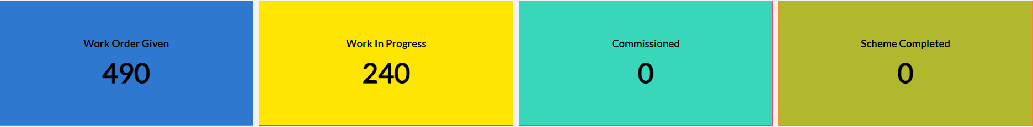
Dashboard
Work Status

Slide 25
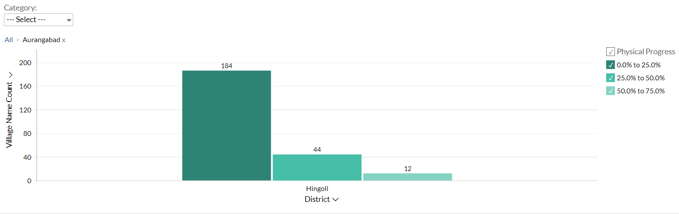
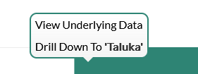
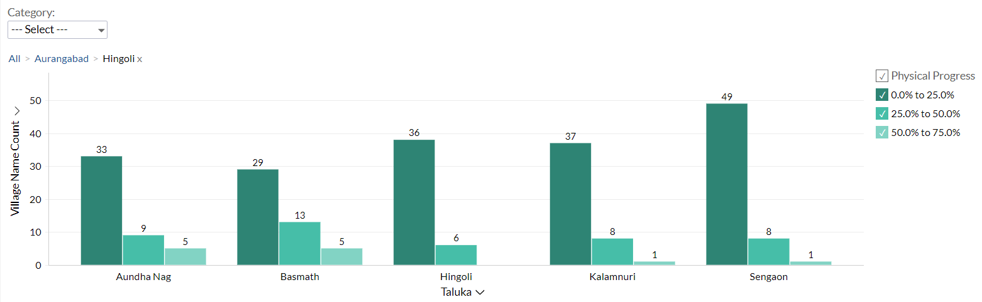
Dashboard
Progress Milestone

Slide 26
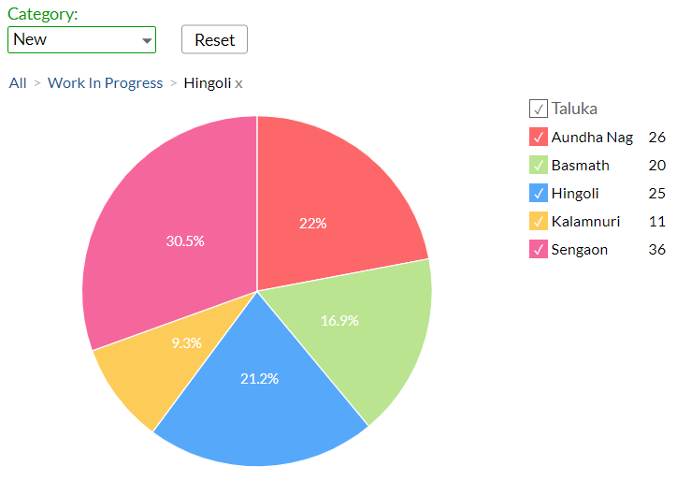
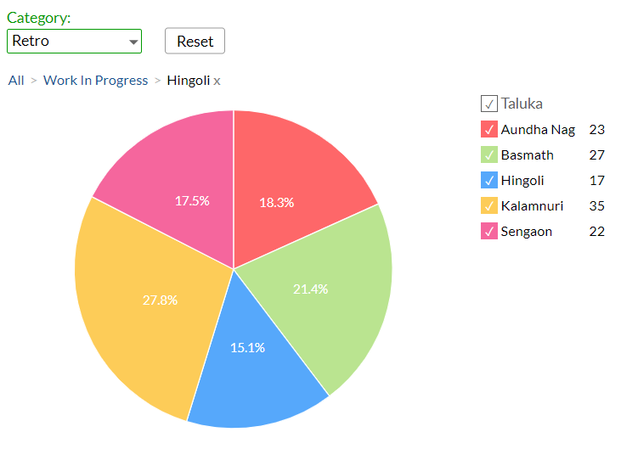
Dashboard
Work Status – “New” Schemes
Work Status – “Retro” Schemes

Slide 27
MS Project
Work in Progress Schemes

Slide 28
Sample Site Visit Photos

Slide 29
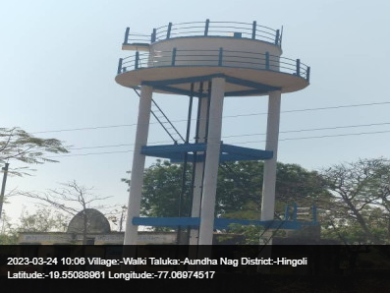
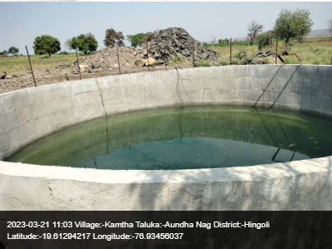
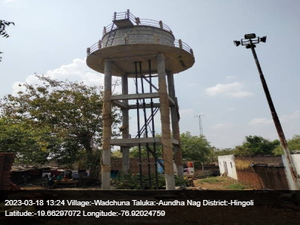
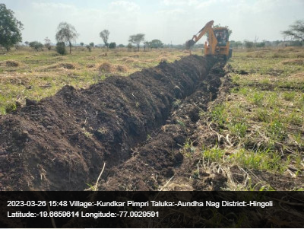
Aundha Nag Taluka

Slide 30
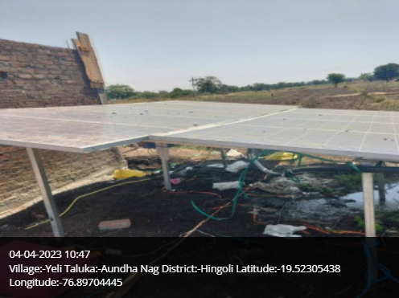
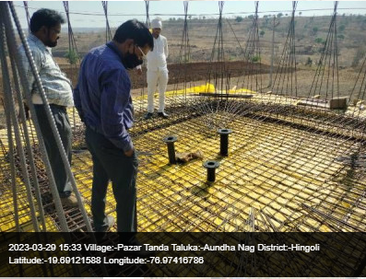
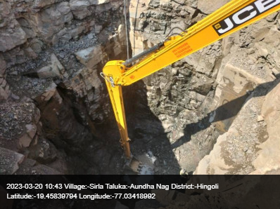
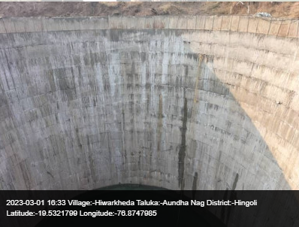
Aundha Nag Taluka

Slide 31
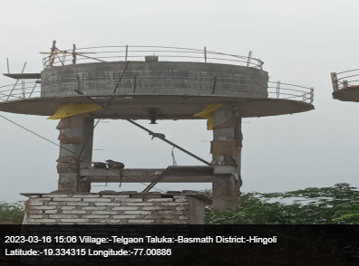
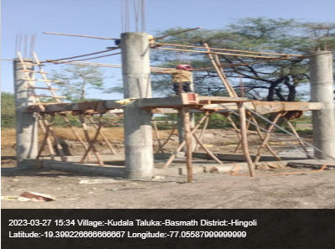
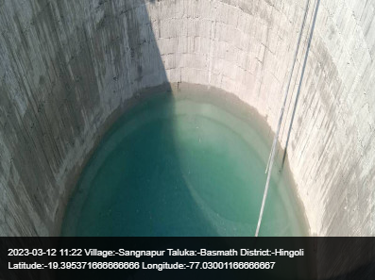
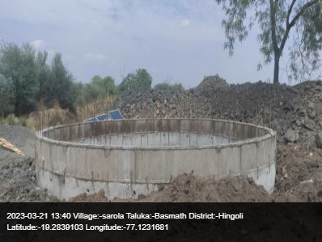
Basmath Taluka

Slide 32
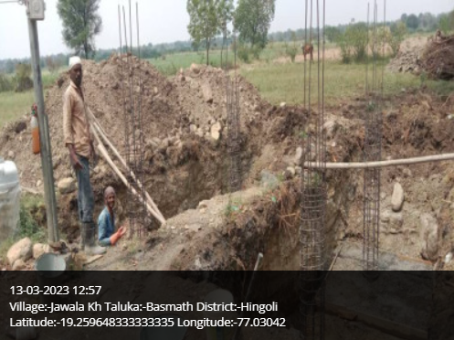
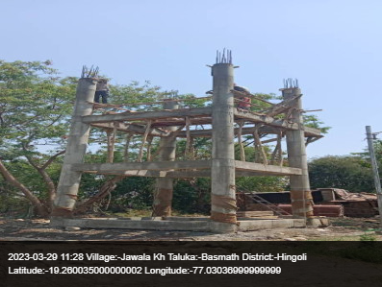
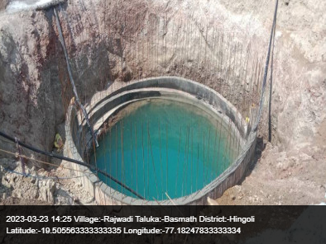
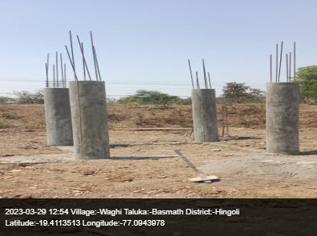
Basmath Taluka

Slide 33
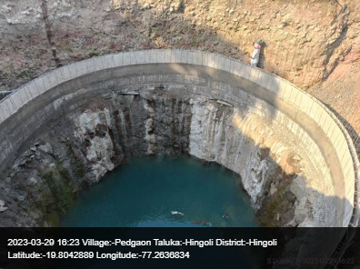
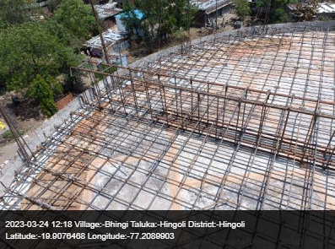
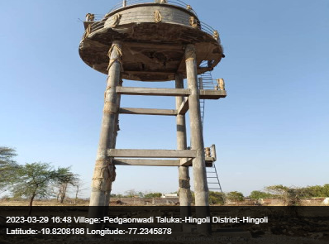
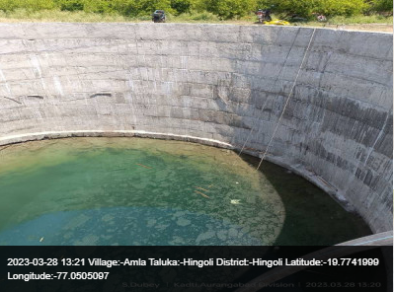
Hingoli Taluka

Slide 34
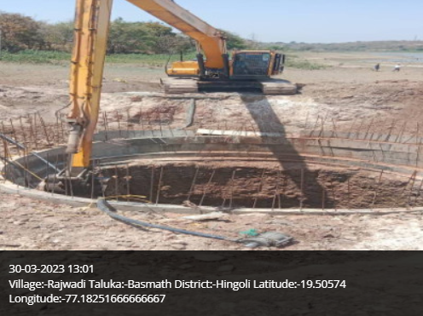
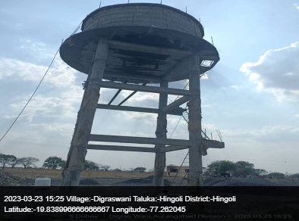
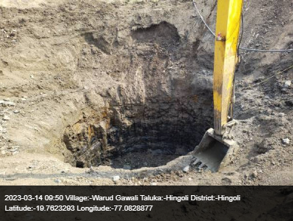
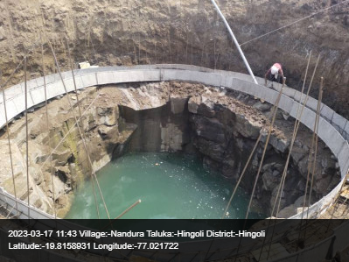
Hingoli Taluka

Slide 35
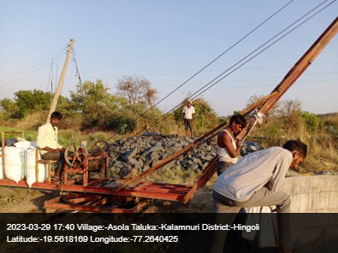
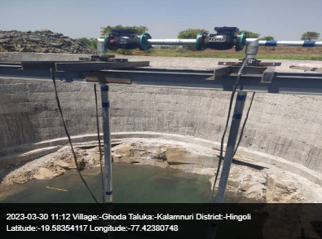
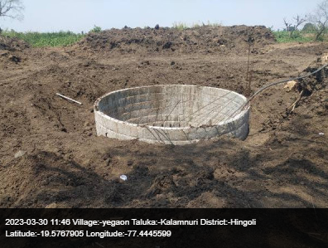
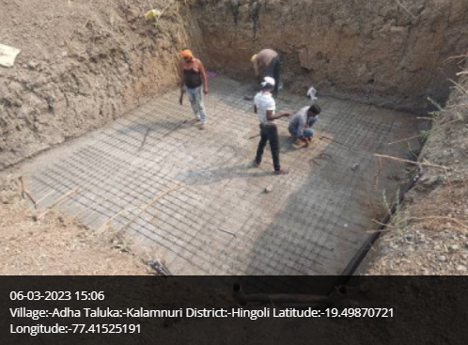
Kalamnuri Taluka

Slide 36
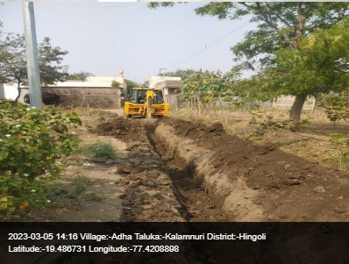
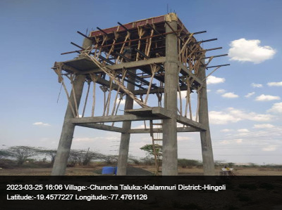
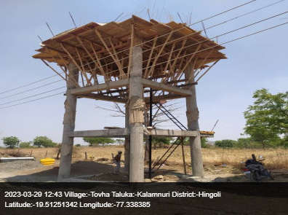
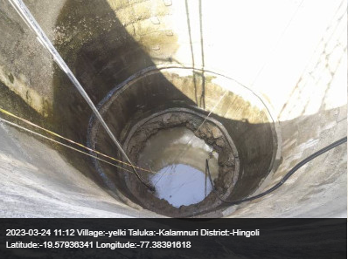
Kalamnuri Taluka

Slide 37
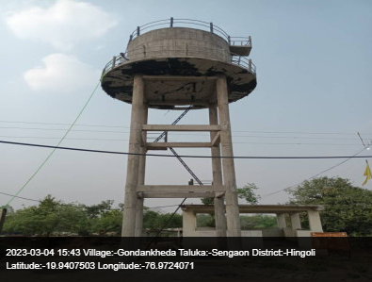
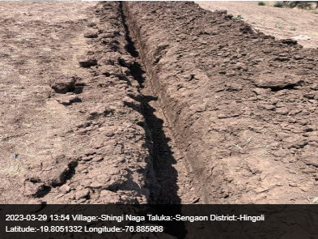
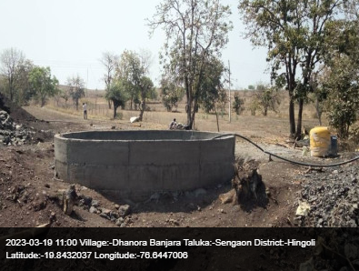
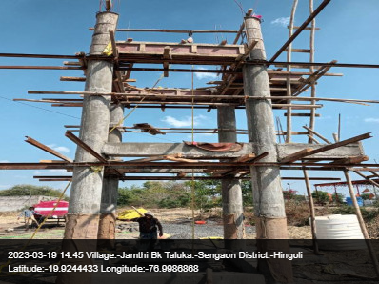
Sengaon Taluka

Slide 38
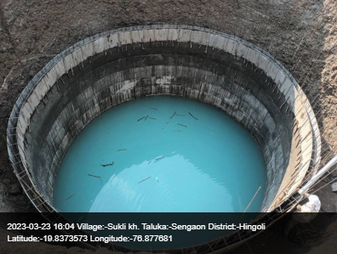
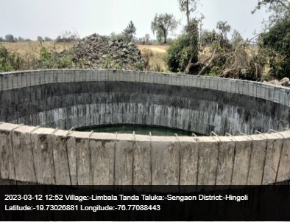
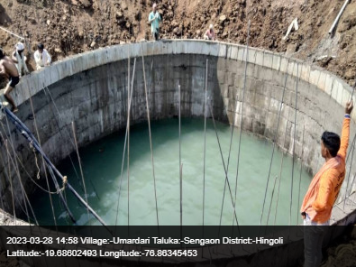
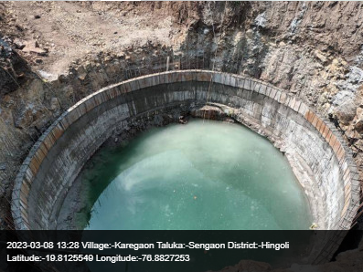
Sengaon Taluka

Slide 39
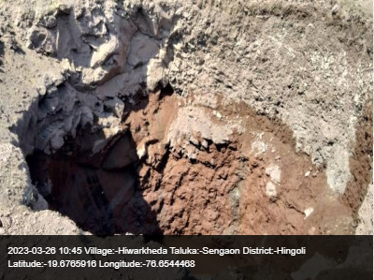
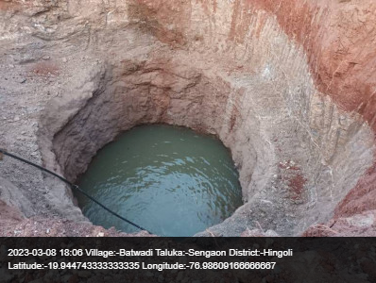
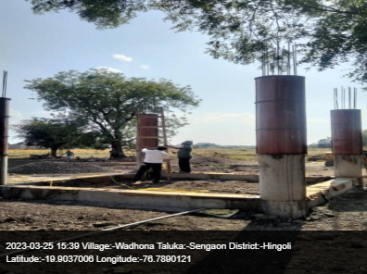
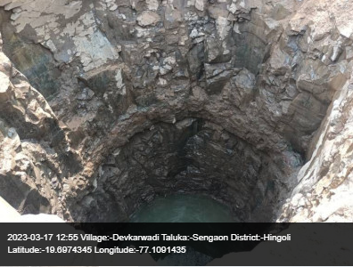
Sengaon Taluka

Slide 40

Thank You!

